Slide 1

Human resources slide 1
Employee Attrition Analysis
Helly Modi

Slide 2
Human resources slide 2
AGENDA
Introduction
Dashboard
Key Insights
Strategic Improvement

Slide 3
Human resources slide 2
Introduction
In recent years, the company has experienced an attrition rate of approximately 15%, significantly impacting its overall performance.
To address this challenge, the organization has engaged an HR analytics consultancy to analyze employee data and uncover the reasons behind attrition.
I will develop a comprehensive dashboard to facilitate data-driven decisions that aim to enhance employee retention.

Slide 4
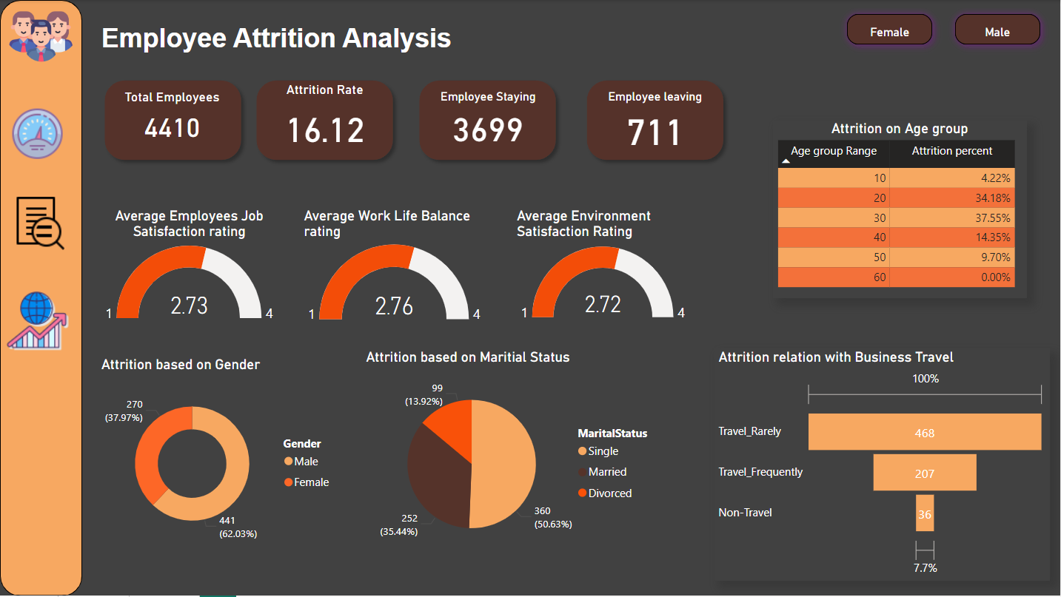
Human resources slide 4

Slide 5
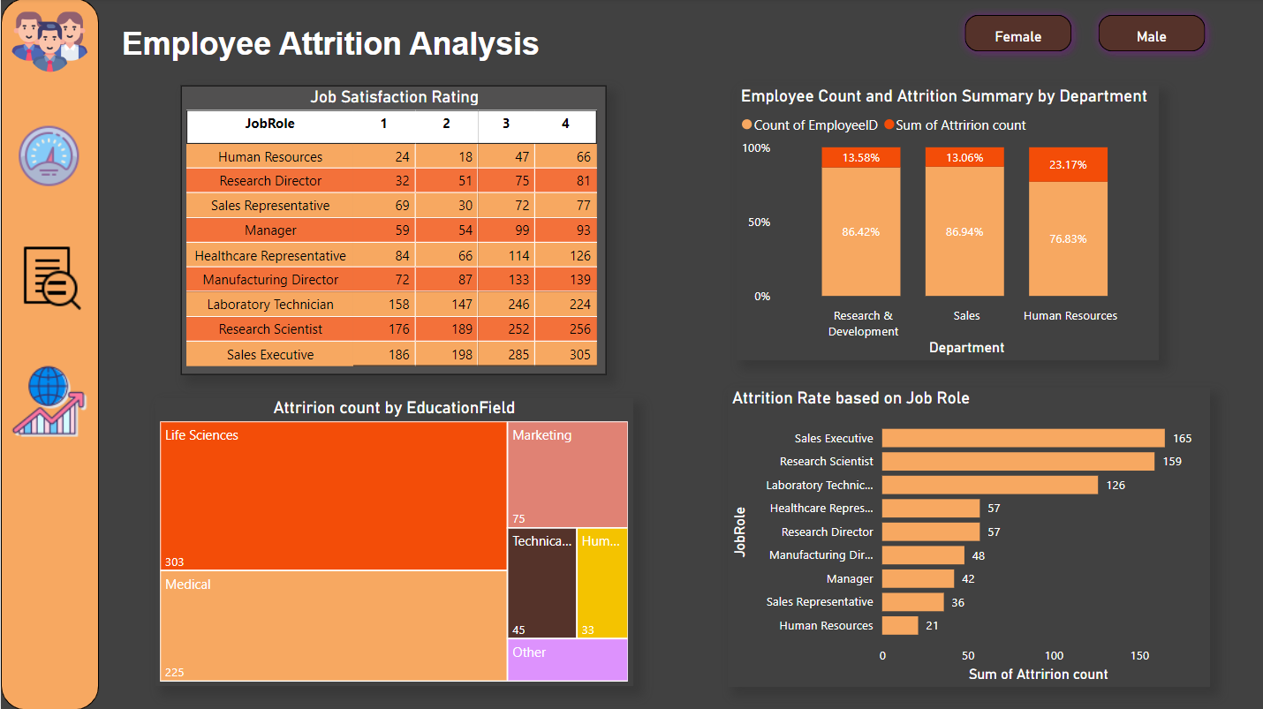
Human resources slide 4

Slide 6
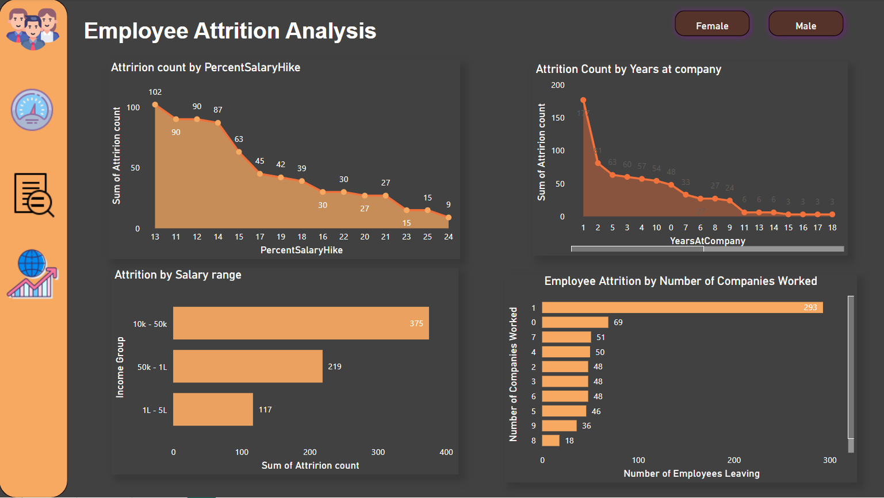
Human resources slide 4

Slide 7

Human resources slide 3
Insights
Attrition Factors
Attrition is highest among employees in their 30s (37.55%) and 20s (34.18%).
Job Role Attrition:
Attrition Rate
16.12%
Average Job Satisfaction
2.73/4
Average work life balance
2.76/4
Sales Executives and Research Scientists experience the highest attrition, with 165 and 159 employees leaving, respectively.
71.73%
Single employees account for the majority of attrition (50.63%), while married employees show a lower rate of turnover.
Education Field:
50%
Life Sciences and Medical fields contribute to the highest attrition.
Employees who travel frequently have a higher attrition rate than those who do not travel or travel rarely
Salary Hikes
65%
Employees who receive smaller raises (10%-15%) showing a significantly higher attrition rate.
Human Resources also has the highest department-level attrition (23.17%).
23.17%

Slide 8

Human resources slide 7
Strategic Improvement
Improve Work-Life Balance:
Tenure
Salary and Benefits Packages:
Job Satisfaction
Introduce programs to promote better work-life balance, such as flexible work hours, remote work options, or reducing mandatory overtime
Most attrition occurs within the first 2-3 years of employment.
Focus on employees in their 20’s and 30’s with personalize retention strategies such as mentorship programs, leadership training, or career opportunity.
Address the issue of lower salary hikes by offering more competitive compensation.
Providing more substantial raises or bonus incentives may increase employee satisfaction and reduce attrition.
Conduct regular or monthly surveys to track sentiment and improve engagement.

Slide 9
Human resources slide 7
Strategic Improvement
Education and Skill Mismatch:
Business Travel Impact
Department-Specific Attrition
Employees with higher qualifications might feel underutilized, and those with lower qualifications might feel overwhelmed.
Provide upskilling opportunities and offer more challenging roles for highly educated employees.
Consider reducing the frequency of business travel or offer incentives like additional time off or rewards for employees who travel frequently.
Ensuring that employees who travel feel valued can help mitigate attrition rates.
Conduct employee satisfaction surveys within these departments and resolve team-specific issues.

Slide 10
Human resources slide 10
Thank You
By Helly Modi

